Slide 1
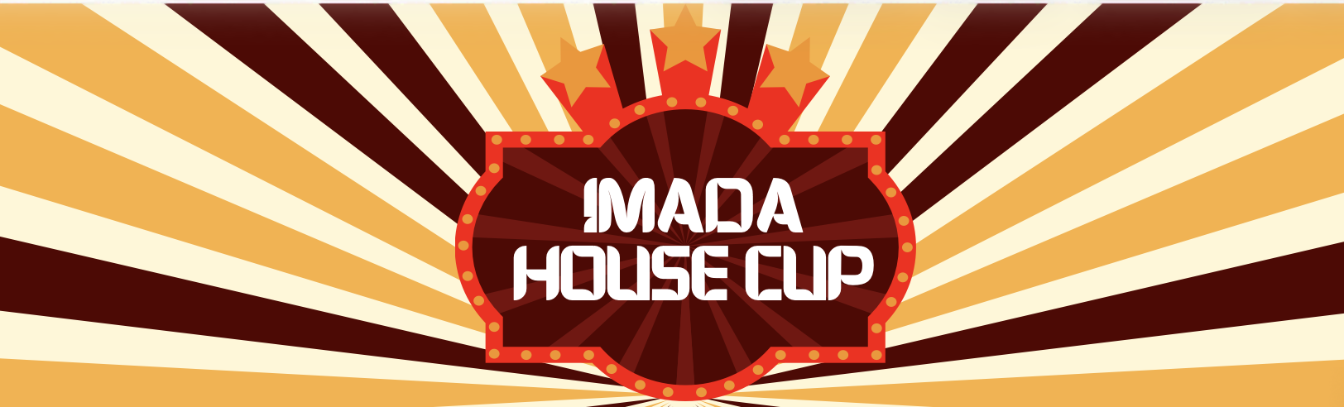

Slide 2
Tidsplan
15.30 - Registration
16.00 - The Student Councils competition
17.20 - Pause
17.30 - Peters competition
18.50 - Prizes/The end
19.00 - Pizza

Slide 3
Registration

Slide 4

The Students Councils competition

Slide 5
The Students Councils competition
Standard Python
2 Tasks
Syntax help
Generative AI
✅
2 difficulties
❌

Slide 6
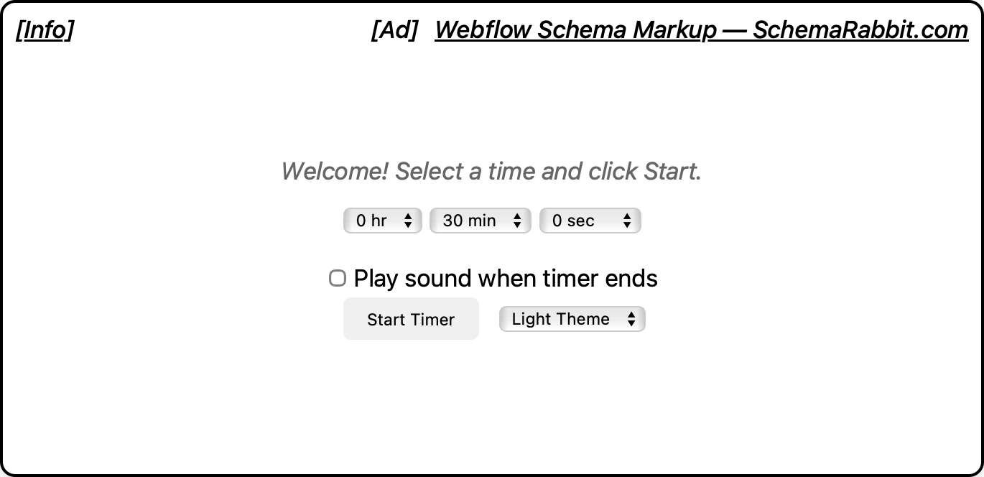
The Students Councils competition

Slide 7
Prizes!

Slide 8
Pause
10 min

Slide 9
IMADA House Cup Quiz

Slide 10
Prizes!

Slide 11
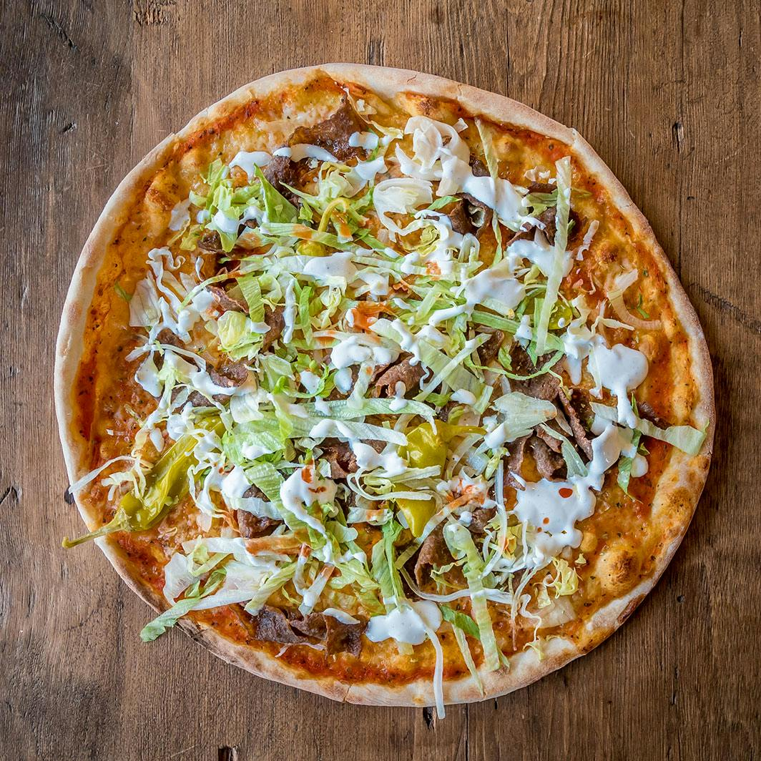
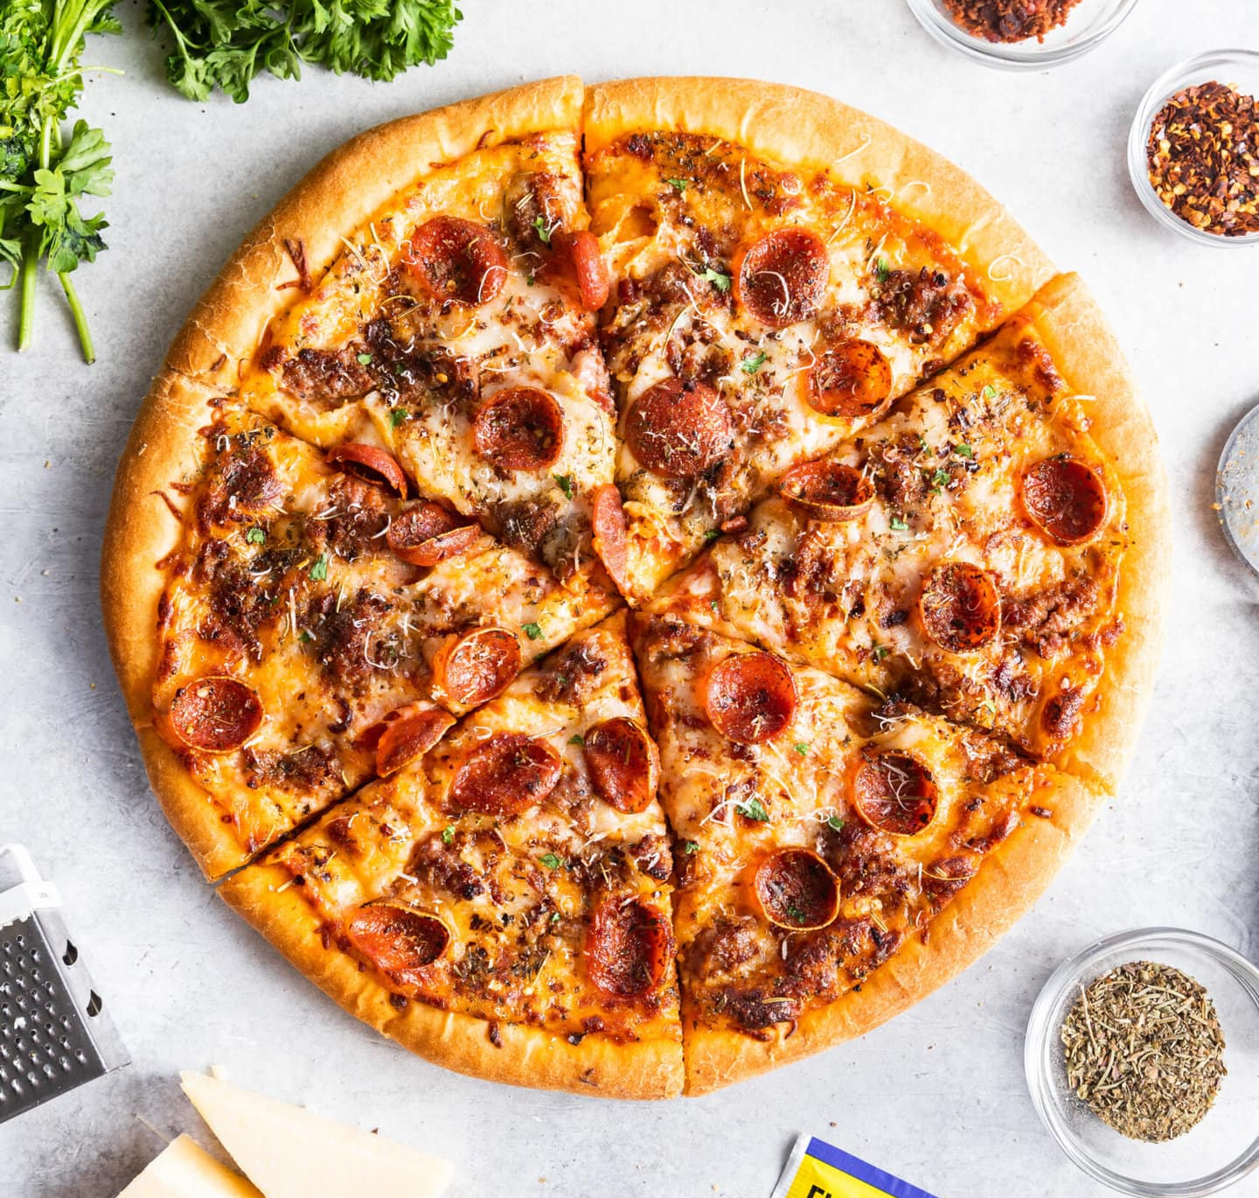
Pizza time

